Slide 1
Unit 202: Principles of electrical science
Force on current-carrying conductor

Slide 2

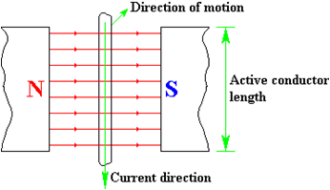

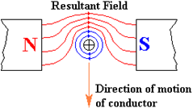
Force on current-carrying conductor

Slide 3
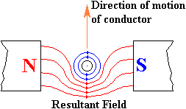

Force on current-carrying conductor
Changing direction of current

Slide 4
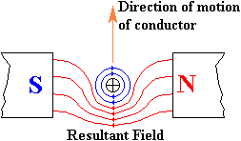
Force on current-carrying conductor
Changing direction of flux

Slide 5
Force on current-carrying conductor
where: | F | = | Mechanical force exerted on the conductor, measured in Newtons (N)
 | B | = | Flux density of main magnetic field measured in Wb⁄m² – teslas (T)
 | I | = | Current flowing in conductor measured in amperes (I)
 | L | = | Length of conductor in the magnetic field measured in metres (m)

Slide 6
Force on current-carrying conductor
EXAMPLE 1. A conductor of 20cm in length is situated perpendicularly in a magnetic field of flux density of 5 teslas and has a current of 10A flowing through it. Calculate the force on the conductor.
F | = | B.I.L.
 | = | 5 × 10 × 0.2
 | = | 10 Newtons

Slide 7
Force on current-carrying conductor
EXAMPLE 2. A conductor of 0.5m in length is situated perpendicularly in a magnetic field of flux density of 10 teslas and has a current of 15A flowing through it. Calculate the force on the conductor.
F | = | B.I.L.
 | = | 10 × 15 × 0.5
 | = | 75 Newtons

Slide 8
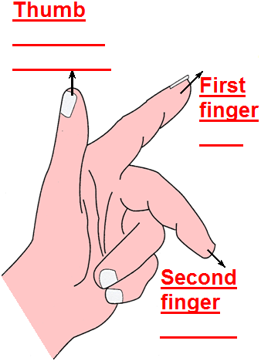
Force on current-carrying conductor
Direction of motion
Fleming’s left hand motor rule
Field
Current

Slide 9
Unit 202: Principles of electrical science
The End

